Slide 1

ONLINE COMPILER USING CLOUD COMPUTING
Computer Science Project II– CS692
Anchal Singh
Ramesh Kyasaram
Brandon Mercado
Tushar Rakholiya
Sanath Gholap
Harshada Chaudhari

Slide 2
INTRODUCTION
In today’s fast and competitive world everything is available on internet, and on web. So, we developed an online compiler using cloud computing. The main objective of this project is to develop a centralized compiler that helps to reduce problems like portability storage, cost, and space.
It is the most convenient tool to compile code, remove errors and debug code. Moreover, we can run the web-based application remotely from any network connection that is independent of platform. The challenge of installing a compiler on each machine is also avoided and one can perform online exams therefore, all these benefits make this application suitable of cloud based online compiler.

Slide 3
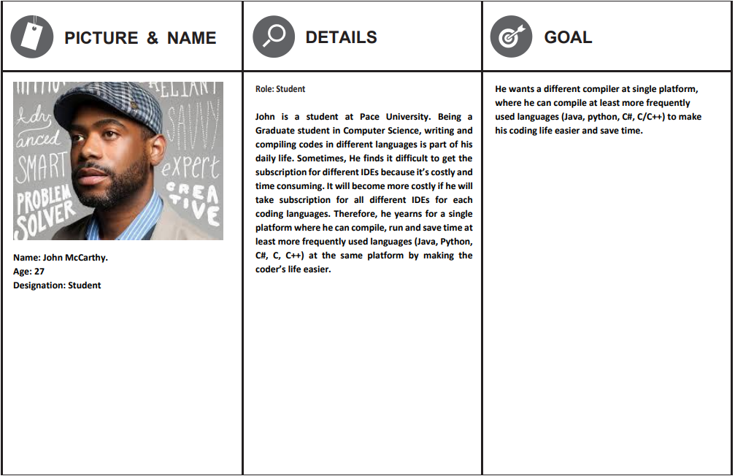
PERSONA 1

Slide 4
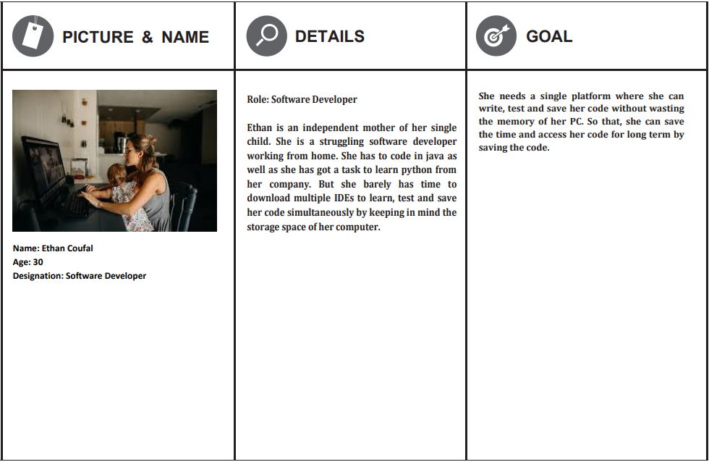
PERSONA 2

Slide 5
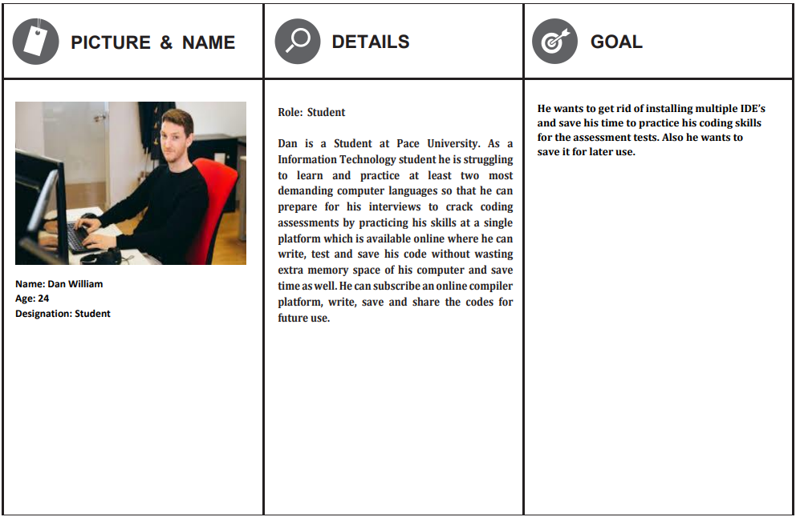
PERSONA 3

Slide 6
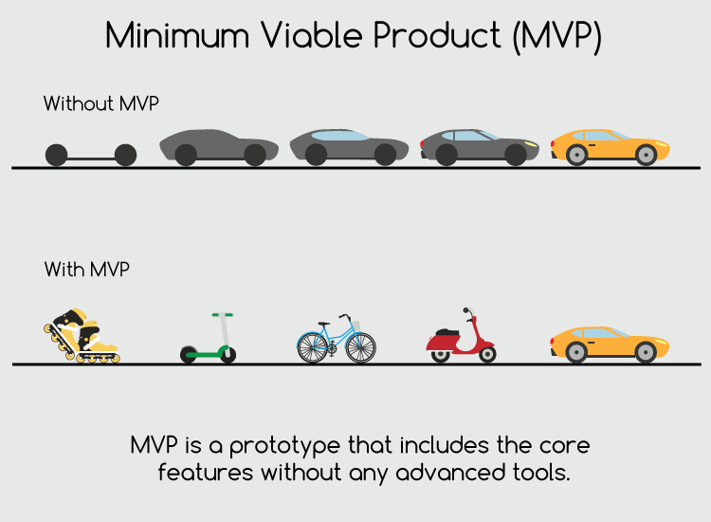
MVP
Which Problem does it solve!
It can be hectic for students or working professionals to download IDEs and virtual machines for individual languages to run their programs in very short amount of time.
Minimum :- An application which can compile or debug the code and get the desired output.
Viable : An online platform for everyone where anyone can run the code in any of the given programming languages with features like save the source code.
Minimum + Viable :- We are presenting a product which is based on cloud computing with features like login, registration with authentication and compilation of source code.

Slide 7
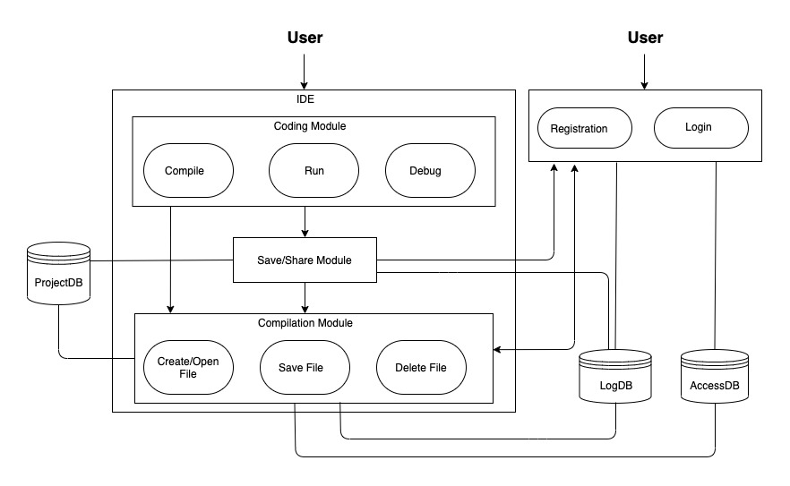
SYSTEM ARCHITECTURE

Slide 8
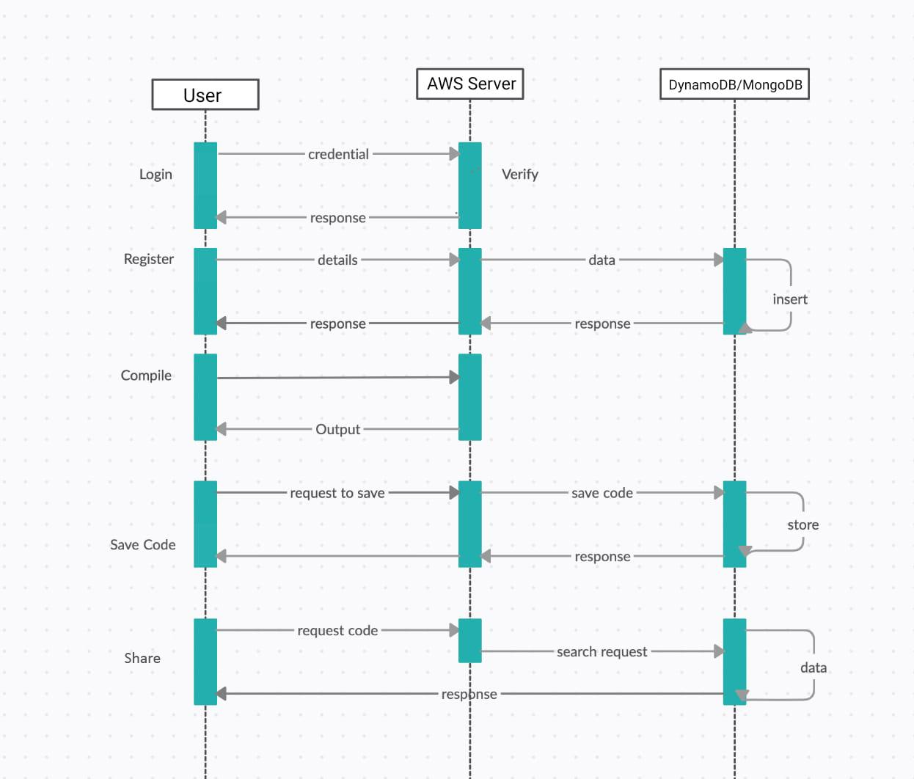
SEQUENCE DIAGRAM

Slide 9
PRODUCT BACKLOG
ID | Stories | As a | I want to | So that | Priority
1 | Compile code | New/ Existing User | Write or paste the source code in the “Enter your code” text area and compile it by clicking on the “Run” button. | I can compile and test my source code. | High
2 | Compilers for C, C++, C#, java and Python | New/ Existing User | Select any of the compilers from the drop-down menu. | I can compile the code in any of the programming languages. | High
3 | Save Code | Existing User | Save code by clicking on the “Save” button. | So that I can store my source code and view it whenever I login using my credentials. | High
4 | Share Code | Existing User | Share code by clicking on the “Share” button. | So that I can share my source code. | Moderate
5 | User Registration | New User | Enter login details that is the first and last name, e-mail and password. | I can create my profile and register myself on the cloud computing service. | Low
6 | Login | Existing User | Enter registered e-mail and password. | I can authenticate my account and after that I can retrieve previously stored source code. | Low

Slide 10
ACCEPTANCE CRITERIA
ID | Stories | As a | Acceptance Criteria
1 | User Registration | New User | 1. Display Website. 2. Display Register or sign in option. 3. A user cannot register without completing all mandatory fields. 4. Information from the form is stored in the registration database. 5. Existing user cannot register again. 6. Commencement and maintaining the session while logged in. 7. Triggers session termination.
2 | Login | Existing User | 1. Login with username/e-mail. 2. Enter password. 3. Forgot username/password.
3 | Compilers for C, C++, C#, Java and Python | New/ Existing User | 1. Display a drop-down menu of the programming languages. 2. Display two text areas for entering the source code and for viewing output/error of the code.
4 | Compile code | New/ Existing User | 1. Display a run button. 2. Programming language should be selected by user from the drop-down menu. 3. There should be code written by the user in the "Enter your code" text area.
5 | Save Code | Existing User | 1. The user must me registered and logged in in-order to use the save feature. 2. Display "Save" button. 3. The programming language should be selected and there should be a code written by the user in the source code area.
6 | Share Code | Existing User | The user must be registered and logged tin-order to use the share feature. Display “Share” button.

Slide 11
TEST CASES
Test Cases for | Test Case ID | Test Scenario | Test Data | Expected Results | Actual Results | Pass/Fail
Registration | 1 | Check registration form with First name | Sanath | NO Validation Errors | NO Validation Errors | PASS
 | 2 | Check registration form without first name | *Blank* | Validation Errors | Validation Errors | PASS
 | 2 | Check registration form with Last name | Gholap | NO Validation Errors | NO Validation Errors | PASS
 | 4 | Check registration form without Last name | *Blank* | Validation Errors | Validation Errors | PASS
 | 5 | Check registration form with vaild email | sanath2097@gmail.com | NO Validation Errors | NO Validation Errors | PASS
 | 6 | Check registration form without email | *Blank* | Validation Errors | Validation Errors | PASS
 | 7 | Check registration form with Password | testpassword | NO Validation Errors | NO Validation Errors | PASS
 | 8 | Check registration form without Password | *Blank* | Validation Errors | Validation Errors | PASS
 | 9 | Check registration form with invalid email | sanathgholap.com | Validation Errors | Validation Errors | PASS
 | 10 | Check registration form with confirming Password | *Wrong password in confirm field* | NO Validation Errors | NO Validation Errors | PASS
Login | 11 | Check Login page with Password | testpassword | NO Validation Errors | NO Validation Errors | PASS
 | 12 | Check Login page without Password | *Blank* | Validation Errors | Validation Errors | PASS
 | 13 | Registration with pre-registered e-mail ID | sanath2097@gmail.com | User Already Exsists Error | User Already Exsists Error | PASS
Compile | 14 | Choosing the language from the drop-down menu with selecting a language | Java/Python/C/C++/C# | NO Validation Errors | NO Validation Errors | PASS
 | 15 | Choosing the language from the drop-down menu without selecting a language | *Blank* | Validation Errors | Validation Errors | PASS
 | 16 | Enter source code in the text area with entering text | Any code | NO Validation Errors | NO Validation Errors | PASS
 | 17 | Enter source code in the text area without entering text | *Blank* | Validation Errors | Validation Errors | PASS
Save | 18 | Check if the source code text area contains code with actual code | Any code | NO Validation Errors | NO Validation Errors | PASS
 | 19 | Check if the source code text area contains code without actual code | *Blank* | Validation Errors | Validation Errors | PASS

Slide 12

TECHNOLOGIES USED
AWS (Cloud Server)
Python(Flask) (Middleware Business Logic)
HTML/CSS (Front-end)
MongoDB (Database)
DynamoDB (AWS Service)
Authy (for MFA/Security purposes)
Boto3 (for communication between
pycharm files to AWS)

Slide 13

SPRINT 5
Sprint 5
Sprint 6
Sprint 7
Sprint 8
Finalized the cloud server i.e., AWS vs. Azure.
Onboarding whole team on AWS platform.
Integration (DynamoDB + AWS).

Slide 14
SPRINT BACKLOG
Sprint Backlog 5 | Module | Priority | Issues Encountered | Start Date | End Date | Status
Sprint 5 : Story 1 | Database | High | Integration of DynamoDB on AWS | 01/26/2021 | 02/18/2021 | Completed
Sprint 5 : Story 2 | Cloud Server | High | Path configuration | 02/3/2021 | 02/19/2021 | Completed

Slide 15
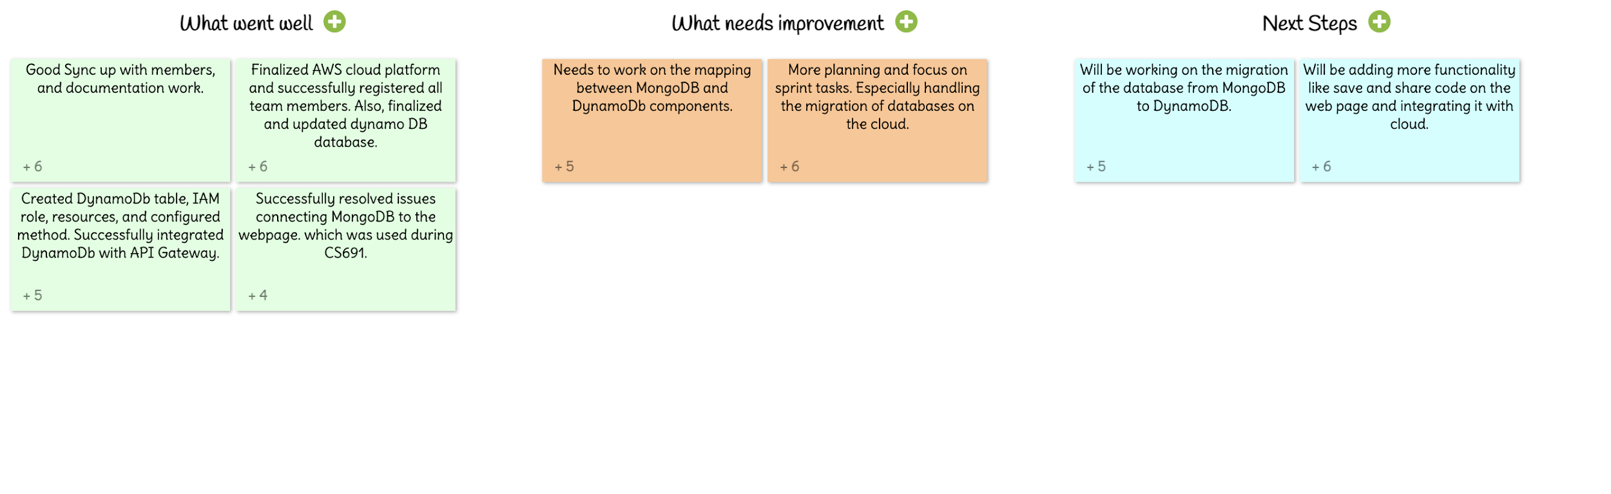
RETROSPECTIVE SPRINT 5

Slide 16

SCRUM MEETINGS
We conduct scrum meetings every Tuesday via Zoom and WhatsApp Group. If needed, we conduct short meetings on the required day according to everyone’s convenience.
The format of our daily scrum meetings consist of 3 main points :
What did you do yesterday?
What is the plan for today?
How close we are to reaching our sprint objectives?

Slide 17

FUTURE SCOPE
We can add a discussion area where registered users can help each other with their difficulties in the code.
We can update our web application to make it more user friendly.
We can expand our application for compiling various other programming languages.
Implement strict privacy for user's data safety.

Slide 18
GITHUB LINK
https://github.com/sg99356n/OnlineCC.git

Slide 19
THANK YOU!

